Slide 1
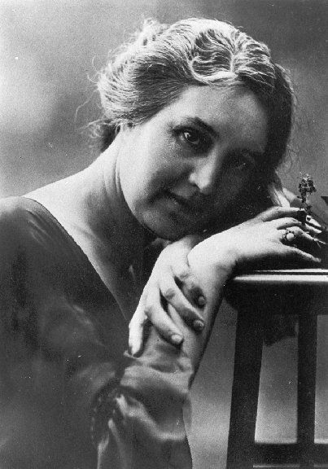
Patriarchy, social and political control in Sibilla Aleramo’s ‘Una Donna’ (1906)
Mairead Hunter & Beatrice Hughes

Slide 2
Introduction
We will be analysing and highlighting evidence of political and social control of the early 1900’s in ‘Una donna’
We will be referring to legislation in Italy at the time such as the Napoleonic and Pisanelli codes, as well as the influence of the Catholic Church
We want to argue that this political control and ecclesiastical influence necessarily oppressed women, giving relevant examples in the book and from other texts.

Slide 3
Background Information – Sibilla Aleramo
Wrote ‘Una donna’ – 1906 whilst in Rome
Already writing feminist articles since 1897
At this time, Italy was entering an industrially productive decade
Unconventional childhood, father = role model
Recognised diverse gender roles of mother and father, questioning of gender roles
Member of ‘Unione Femminile’

Slide 4
The Napoleonic & Pisanelli codes and the Church
Italy- influenced by Napoleonic code – formed basis of Pisanelli code (1865) – Sibilla aware of restrictions that enforce patriarchal control
Division of roles and family legislation – Divorce was forbidden – Sibilla’s recognition of her restricted role solely as male companion
Women placed under husband’s authority – ‘la mia vita fancilla era finita’ (p.27) and they became restricted and dependent on men
Saraceno (1990) - inequalities of these laws: Women excluded from work and seen as wives and mothers; “Ideal” type mother figure –reinforced by the Catholic Church
Women seen as less capable adults due to their domestic responsibilities (Saraceno, 1990) – inequality between gender roles

Slide 5
The Pisanelli code and the Church
Perry (2004) Catholic Church – long history in private sphere: sex and marriage reinforcing women’s primary roles and the concept of family in a patriarchal setting.
Early writings around 1897 – Aleramo adopts conventional Catholic beliefs. In Una Donna, prevailing sentiment – “La mamma vera” (p.5)
Saraceno, (1990) Catholic Church – strong influence over Pisanelli code
Scott, (1980) ideas of Louis de Bonald (1816); Church and state maintained power - patriarchal institutions legislated private family life and women- Aleramo aware of Catholic impositions

Slide 6
Conclusion
Lack of women’s rights and gender roles were rigorously and purposely reinforced by Italian authoritarian and patriarchal institutions at the beginning of the 20th century in order to maintain power.
Aleramo’s book brings explicit attention to these inequalities, focusing on the laws themselves.
Gender roles and the patriarchy were deeply embedded ideologies in Italy and still are today.

Slide 7
‘…the first requirement for democracy in contemporary societies is that it should represent all citizens, providing equal opportunities and voice in the governance of the public domain.’ Shahra Razavi

Slide 8
Bibliography
Aleramo, S. 1999 [1906].Una donna. Milan: Feltrinelli
Caesar, A. ‘Italian Feminism and the Novel: Sibilla Aleramo’s “A Woman”’, Feminist Review, 1980, 3, 79-87
Caldwell, L. Italian Family Matters: Women, Politics and Legal Reform, Palgrave: Hampshire, 1991
Phillips, R. “Women and Family Breakdown in Eighteenth Century France: Rouen 1780-1800”, Social History, 1976 ,2, 217
Saraceno, C. 'Women, Family and the Law, 1750 - 1942', Journal of Family History, 1990, 15: 427, Sage Publications
Scott, J. ‘Gender: A Useful Category of Historical Analysis’, The American Historical Review, 1986, 91, 5, 1053-1075
Razavi, S. ‘Women In Contemporary Democratization’. International Journal of Politics, Culture, and Society, Vol. 15, No. 1, 2000, 201-224
Wilson, P. Gender, Family and Sexuality. The Private Sphere in Italy 1860-1945, Basingstoke : Palgrave Macmillan 2004

